Slide 1

School of Computing and Computer Engineering
CSC 691 PROJECT ON NEURAL NETWORK AND MACHINE LEARNING
AIR POLLUTION PREDICTION IN SMART CITY
LECTURER: DR. ANDREW SUNG STUDENT: SOHAIL KHAN W10154009
Page: 1

Slide 2
PROBLEM DESCRIPTION:
The increase in the percentage of the urban population in the world shows that people more and more are moving to cities. According to United Nations (UN), the urban population as of 2020 is about 56.15% [1]. And it is expected that it will become 68% of the world’s population will live in urban cities by 2050 [2]. In order to resolve these issues, and improve the quality of its citizens’ lives, the smart city concept was created by integrating Information and Communication Technology (ICT), and fixed/mobile sensors
One of the hazardous pollutants is a fine particulate matter whose size is 2.5μm or less, also known as PM2.5. such particle results in serious health damage.
According to recent studies, 90% of people breathe polluted air that exceeds the limits of WHO guidelines in terms of air quality [3], bringing about respiratory problems. [4, 5]
Even a few hours to weeks of short-term exposure to PM2.5 can trigger cardiovascular disease-related mortality and events [6].
The Global Burden of Diseases GBD identified that Exposure to PM2.5 contributed to 4.2 million deaths and 115.1 million disability-adjusted life years (DALYs) globally in 2015 [7] with an increase in 2017 (4.58 million deaths and 142.52 million DALYs) [8].

Slide 3
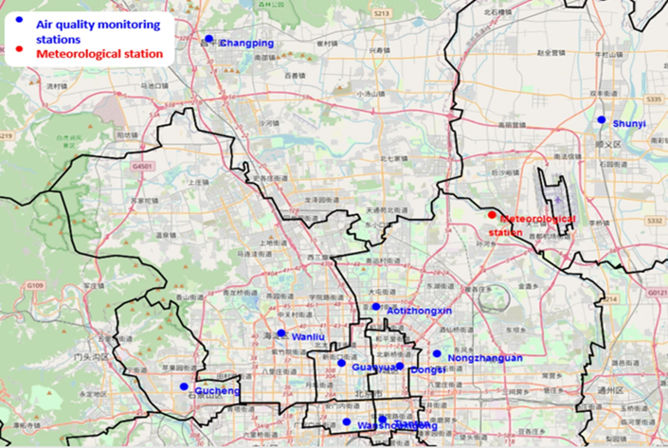
DATASET:
The dataset we have chosen (420768 instances and 18 attributes) comes from the UCI Machine Learning Repository [9]. this dataset shows the concentration of air pollutants and air quality at 12 sites. The air quality data comes from the Beijing Municipal Environmental Monitoring Center. The meteorological data indicating the air quality for each site is matched with the nearest meteorological station of the China Meteorological Administration.
This dataset includes 35064 records with multi-features in each station. The period of recording is from March 1st, 2013, to February 28th, 2017. The data are composed of:
Date.
The concentration of PM2.5, PM10.
Sulfur dioxide SO2.
Nitrogen dioxide NO2.
Carbon monoxide CO. Page: 3

Slide 4
Ozone O3.
Dew point.
Temperature.
Atmospheric pressure.
Combined wind direction.
Cumulated wind speed. cumulated hours of snow, and rain. However, Air quality and meteorological monitoring equipment will cause leakage in data collection due to machine failure, due to some uncontrollable reasons.
METHODOLOGY:
The forecasting of air quality can be considered as a non-linear regression problem between predictors (such as meteorological and air quality variables) and predictand (in this case, hourly concentration). Neural networks, in particular the multi-layer perceptron provide a flexible and non-linear tool for tackling regression problems in the air quality modelling (Gardner and Dorling, 1999). There are arguments, which both support and explain the wide use of the MLP in that domain. Primarily, extremely non-linear relationships exist in the real world and it is inappropriate to attempt to understand these problems using traditional regression. Moreover, it has been shown that the Multi layer perceptron can be trained to approximate any smooth, measurable (highly non-linear) function without prior assumptions concerning the data distribution.
Page: 4

Slide 5
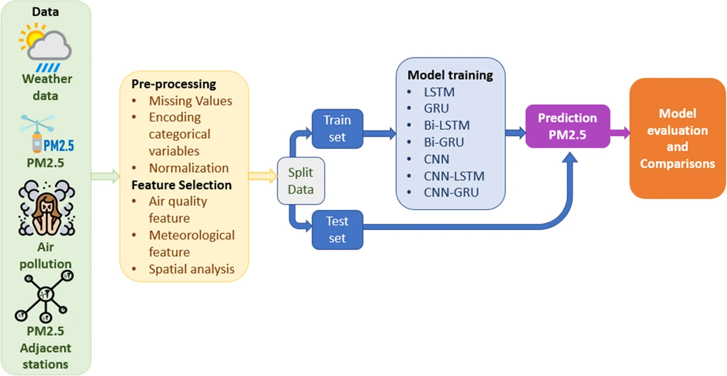
Each network attempts to predict the results as accurately as possible. The value of the accuracy in the network is achieved by the cost function trying to punish the network when it fails. The optimal output is the lowest cost.
In this study, for all networks, we have applied MSE (Mean Squared Error) as a cost function. A repetition step in training generally works with a division of training data named a batch size.
Page: 5

Slide 6
The methodology will mainly include three steps:
1.) Data pre-processing:
Missing values.
Encoding categorical variables.
Normalization.
2.) Feature selection: In machine learning applications, features selection is an essential step that can be done in several ways. Most of the previous work has applied a mathematical correlation to find the relationship between the input and output variables. The most popular way to find correlation between two variables is Pearson correlation.
Air quality feature.
meteorological feature.
spatial feature.
3.) Evolution index of models: Once the structure of the model is determined, the training set is used to train the network until convergence. In order to assess the efficiency of the model, three indicators are used, including the mean absolute error.
Page: 6:

Slide 7
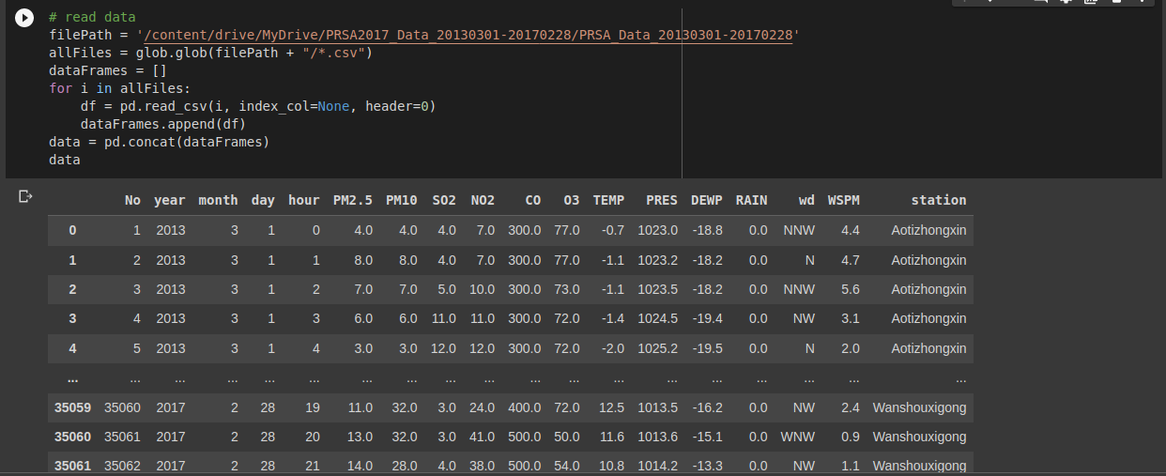
Loading Datasets and Viewing the first 5 rows of the Data: The image below, shows the loading of the dataset. The dataset to be used, is first uploaded to google drive and its path is copied and later pasted, this is the method of loading the dataset while using google colab. In order to confirm that the uploaded data is accurate, there is the use of command ‘data’.
Page: 7

Slide 8
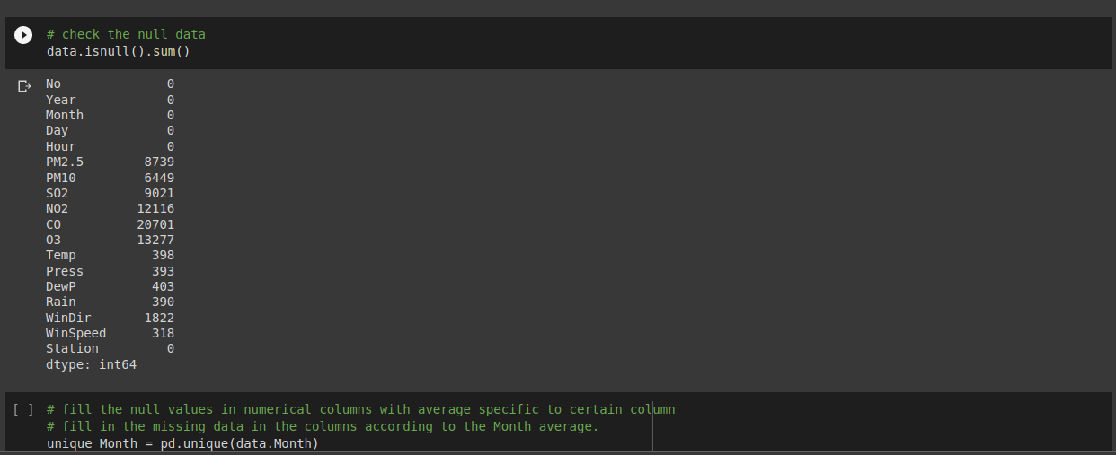
Data Pre-processing: Data is collected in various ways and the collected data can be having a lot of unorganized values which are not used while training the model. The code below shows data pre-processing which is for removing unnecessary data or missing data which helps with the accuracy of the models.
Page: 8

Slide 9
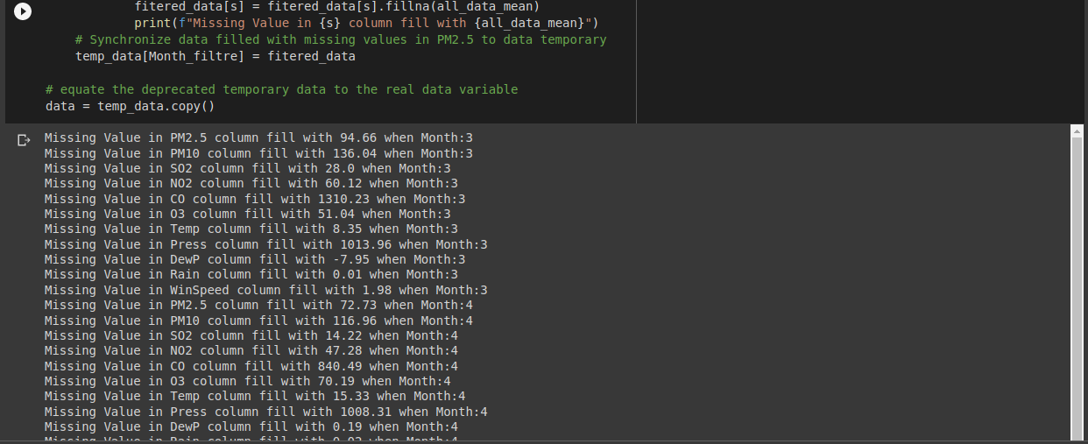
Data Preprocessing Continued:
Page: 9

Slide 10
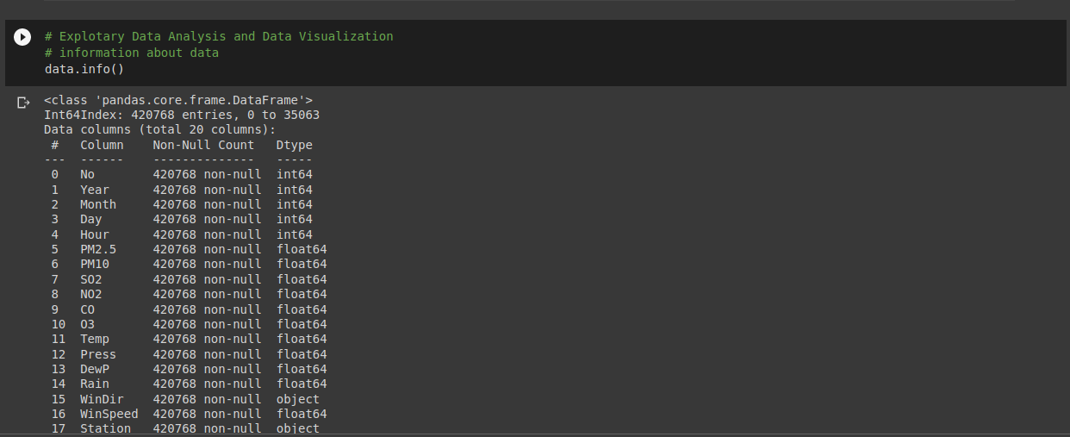
Exploratory Data Analysis Data Visualization: In order to get an insight about the dataset that is used, there is the need of explore of the dataset, this is to know the object values, the null values the int values. In simple terms, data analysis or data visualization is for helping to get more insight about the dataset.
Page: 10

Slide 11
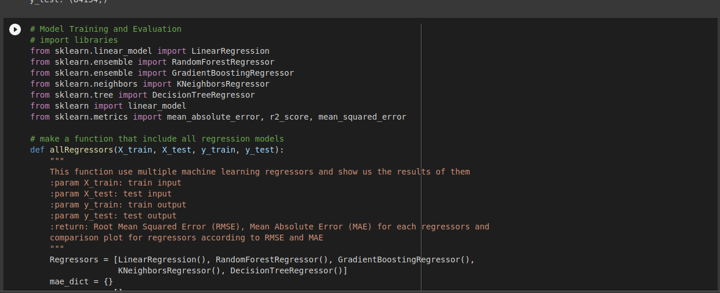
Model Training and Evaluation: this is the most important part of the development, this is where you want the model to be trained and this is done by first importing the libraries from sklearn. Algorithms such as Linear Regression, Random Forest Regression, Gradient Boosting Regressor, K-Neighbors Regression, and Decision Tress Regression were imported.
Page: 11

Slide 12

Model Training: Dataset is first split into the training dataset and the testing dataset, the training dataset is used to train the model and the testing dataset is used to test the dataset.
Page: 12

Slide 13
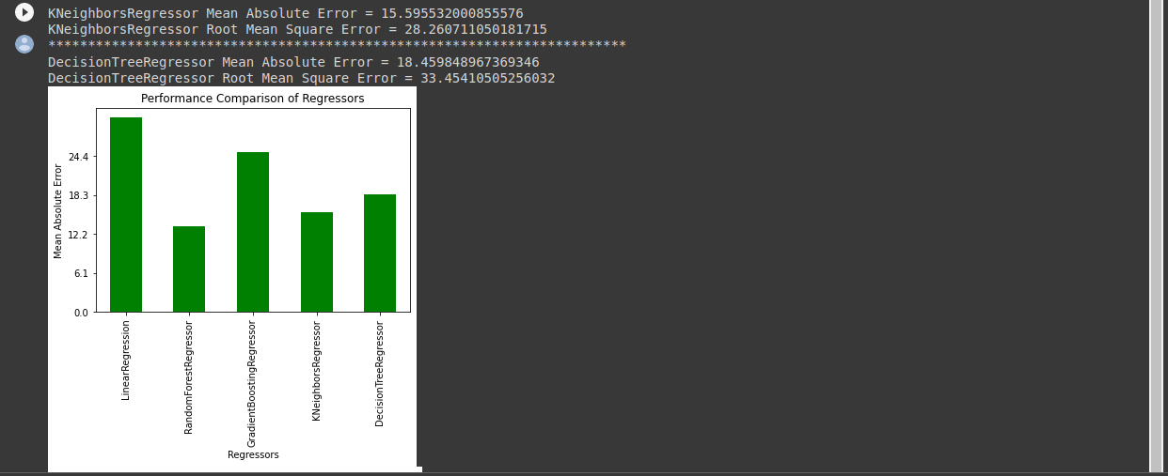
Model Evaluation: this is where there is the use of different evaluation metrics in order to determine the performance of a model, in this project I used Root Square Error and Mean Absolute Error in order to evaluate the performance of the model. The image below explains more about the same.
Page: 13

Slide 14
Performance Comparison of the Regressors: this section is whereby I did a comparison of the regressions against mean absolute Error which is necessary to know the best-performing regression.
Page: 14

Slide 15
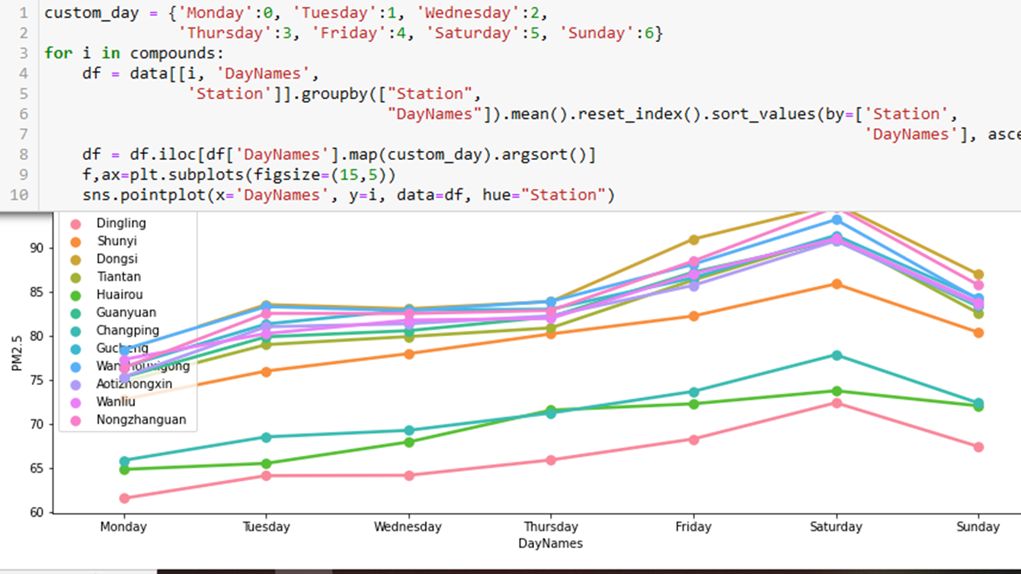
Multilayer Perceptron A feedforward artificial neural network that produces a set of outputs from a set of inputs is called a multilayer perceptron (MLP). A directed graph connecting the input and output layers of an MLP is made up of multiple layers of input nodes. Backpropagation is used by MLP to train the network. Inputs made are the number of days and the results are seen below.
Page: 15

Slide 16
REFERENCES:
1.) Urban population (percentage of total population). https://data.worldbank.org/indicator/SP.URB.TOTL.IN.ZS
2.) Department of Economic and Social Affairs: Urban Population Change; 2018. https://www.un.org/development/desa/en/news/population/2018-revision-of-world-urbanization-prospects.html
3.) Nada Osseiran, Christian Lindmeier: 9 out of 10 people worldwide breathe polluted air, but more countries are taking action; 2018. https://www.who.int/news/item/02-05-2018-9-out-of-10-people-worldwide-breathe-polluted-air-but-more-countries-are-taking-action
4.) Ailshire JA, Crimmins EM. Fine particulate matter air pollution and cognitive function among older US adults. Am J Epidemiol 2014;180(4):359–66. https://doi.org/10.1093/aje/kwu155. https://academic.oup.com/aje/article-pdf/180/4/359/8640802/kwu155.pdf.
5.) Pöschl U. Atmospheric aerosols: composition, transformation, climate and health effects. Angewandte Chemie Int Ed. 2005;44(46):7520–40. https://doi.org/10.1002/anie.200501122.
6.) Du Y, Xu X, Chu M, Guo Y, Wang J. Air particulate matter and cardiovascular disease: the epidemiological, biomedical and clinical evidence. J Thoracic Dis. 2016;8(1):8.
7.) Cohen AJ, Brauer M, Burnett R, Anderson HR, Frostad J, Estep K, Balakrishnan K, Brunekreef B, Dandona L, Dandona R, et al. Estimates and 25-year trends of the global burden of disease attributable to ambient air pollution: an analysis of data from the global burden of diseases study 2015. Lancet. 2017;389(10082):1907–18.
8.) Bu X, Xie Z, Liu J, Wei L, Wang X, Chen M, Ren H. Global pm2.5-attributable health burden from,. to 2017: estimates from the global burden of disease study 2017. Environ Res. 1990;2021(197):111123.
9.) Zhang S, Guo B, Dong A, He J, Xu Z, Chen SX. Cautionary tales on air-quality improvement in Beijing. The Royal Society Publishing; 2017. https://archive.ics.uci.edu/ml/datasets/Beijing+Multi-Site+Air-Quality+Data.

Slide 17
Conclusion: I was able to train the dataset and come up with a model that will help. Throughout the project, I have learnt lot of new skills which would definitely help me in the future.
Page: 16

